Slide 1

SARS-CoV-2 genomics contextual data curation and stewardship
Emma Griffiths, PhD
Chair, PHA4GE Data Structures Working Group
Hsiao Public Health Bioinformatics Lab
Faculty of Health Sciences, Simon Fraser University
Vancouver, Canada

Slide 2
Outline
Challenges associated with genomics contextual data
Data standards: solutions for harmonization
PHA4GE SARS-CoV-2 specification
Resources for putting standards into practice
Data stewardship
Wrap up & links

Slide 3





Contextual data is critical for interpreting the sequence data.
Sequence data
Contextual data (metadata) used for surveillance and outbreak investigations:
characterize lineages and clusters
identify variants with clinical significance
correlate genomics trends with outcomes, risk factors
inform decision making for public health responses and monitor effects of interventions
Contextual data
Sample metadata
Lab results
Clinical/Epi data
Methods

Slide 4
Harmonizing fields of data is challenging.
A field by any other name does NOT smell as sweet…
SPECIMENSOURCE_1
Differences in labels,
Same meaning
Isolation
The labs mean “sample type”
host_tissue_sampled
Computer doesn’t recognize these as the same thing
Source
Same label,
Different meaning
The lab means “submitting lab”
Source
Computer doesn’t recognize these as different
…so, you can’t just combine fields of data.

Slide 5

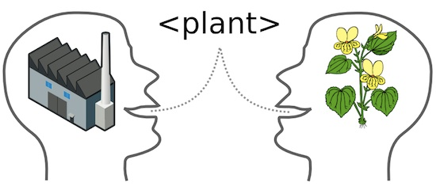

Harmonizing information inside fields is challenging.
Free text =
Sever Acute
Repiratry Sickness
SC2
Date:
2021-04-26
April 26, 2021
26-Apr-2021
Errors
Short hand
Semantic ambiguity
Formats
Inconsistently
collected
Notes:
Free text is difficult to mine

Slide 6
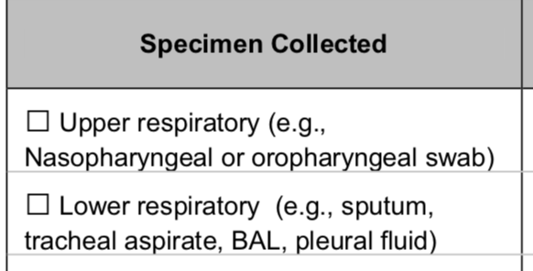
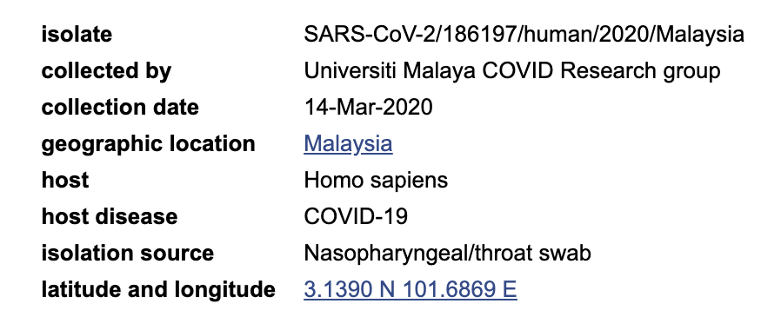
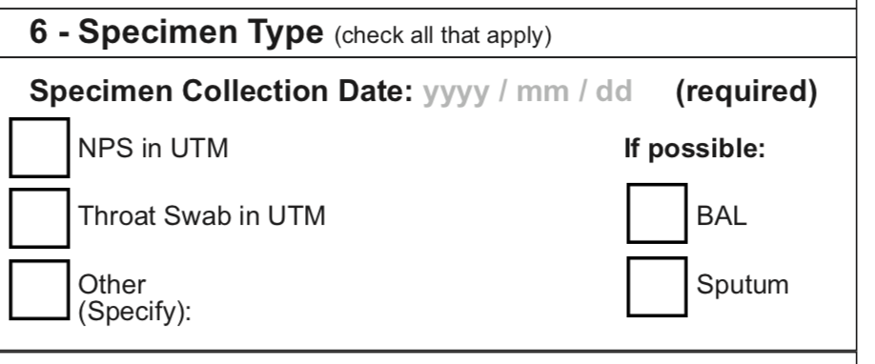
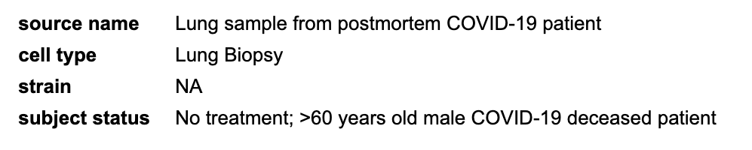
Getting the right information to the right people is critical during health emergencies.
Need to share data: within organization, with trusted partners, with international agencies/public repositories
Data structure variability in local databases propagates to public repositories
Private databases:
Public databases:

Slide 7
Different data structures make information less interoperable and more difficult to integrate.
That means you need to spend more time and resources to clean/re-structure information before you can use it.
Best practices for data management/stewardship/structure are critical parts of SARS-CoV-2 sequencing and analyses.

Slide 8
Data standards: Solutions for standardizing contextual data
Data dictionaries:
Fields, flat list of terms, formats
Data dictionaries fulfill particular purposes
Organization or project specific project (ease of use)
Minimum Information Checklists:
Prescribed fields to describe something (in a particular context)
created by authoritative source
core fields common between checklists (e.g. collected by, sample collection date, sample ID)
specific packages provide fields for specific contexts (e.g. air, human gut)
commonly used by international sequence repositories
e.g. Pizza Type
Cheese pizza
Meat Lover’s Pizza
Veggie Pizza
e.g. MIAP (Min Info About a Pizza)
Pizza Type:
Topping:
Crust:
Sauce:

Slide 9
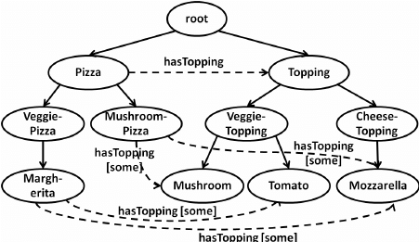
Ontology, A Way of Structuring Information
Ontologies aim to represent truth. Is this universal?
Controlled (standardized) vocabulary
Hierarchy (granularity)
Logic
Definitions and unique IDs (disambiguation)
e.g. Veggie Pizza (FoodOn:1234)
A type of pizza that is topped with only vegetable and cheese toppings.
e.g. Margarita – synonym of Margherita?
IDs distinguish between pizza and cocktail
Synonyms (facilitates mapping)
Prepares data for more variety of analyses
hasRecipe
hasCookingTime
hasPreparationDate
Veggie pizza (FoodOn:1234)
Margherita pizza (FoodOn:1240)
synonym: Margarita pizza
Margarita cocktail (FoodOn:2376)
Synonym: Margarita

Slide 10
Contextual data ecosystem: putting standards into practice
Implementation, Curation & User engagement
Software & Tools
Data Standards

Slide 11
The SARS-CoV-2 Contextual Data Standard
SARS-CoV-2 Domain Content
Repository accession numbers and identifiers
Sample collection and processing
Host information
Host exposure information
Host reinfection information
Host vaccination information
Sequencing methods
Bioinformatics and quality control metrics
Lineage and variant information
Pathogen diagnostic testing details
Provenance and attribution
Data Sources
Case report forms
Public repository requirements
Existing metadata standards
Literature
Mapping to Standards
MIxS 5.0
MIGS Virus, Host-Associated
Project/Sample Application Standard
OBO Foundry Ontologies
PHA4GE SARS-CoV-2 Specification
https://github.com/pha4ge/SARS-CoV-2-Contextual-Data-Specification

Slide 12
Putting standards into practice: Template and standard terminology
Standardized collection template (colour-coded, yellow=required, purple=recommended, white=optional)
Pick lists: standardized terms
Structured formats e.g. for dates
JSON schema

Slide 13
Guidance documentation
Reference guide: field labels, definitions, guidance, expected values
SOP: how to curate contextual data

Slide 14
PHA4GE standard quick FAQ
Do I have to fill in the whole thing?
NO! Only use the parts you need. We’ve highlighted the most important bits.
Is this just for human/clinical samples?
NO! It’s for ALL samples.
Do I have to share all my contextual data?
NO! It’s all up to you!
What happens if your pick lists don’t have the term I want?
1. Get in touch with us!
2. SOP shows you how to find a standardized term.

Slide 15
Worked Examples
State X reference lab in Country Y has a border testing program.
A 36 year old female from Canada visiting Country Y tests positive for SARS-CoV-2.
An NP swab was collected on March 16 2021.
The sample was sequenced by State X reference lab using an amplicon strategy according to the ARTIC V4 protocol.
The consensus genome was generated iVar 1.3.2.
specimen collector sample ID: ABCD1234
sample collected by: State X Reference Laboratory
sequence submitted by: State X Reference Laboratory
sample collection date: 2021-03-16
geo_loc name (country): Country Y
geo_loc name (state/province/territory): State X
purpose of sampling: Diagnostic testing
purpose of sampling details: Not Provided
purpose of sequencing: Travel-associated surveillance
purpose of sequencing details: border testing program
organism: Severe Acute Respiratory Syndrome Coronavirus 2
anatomical part: Nasopharynx (NP)
collection device: Swab
host (scientific name): Homo sapiens
host age: 36
host age unit: year
host gender: Female
host residence geo_loc name (country): Canada
travel history: individual travelled directly from Canada
amplicon pcr primer scheme: ARTIC V4
amplicon size: 400bp
consensus sequence software name: iVar
consensus sequence software version: 1.3.2
*Null values:
Missing
Not Applicable
Not Collected
Not Provided
Restricted Access

Slide 16
Worked Examples
State X reference lab in Country Y in investigating an outbreak at Hospital Z.
A previously vaccinated individual (one dose AZ, Feb 1 2021) tests positive for SARS-CoV-2, with a diagnostic PCR CT value of 23 (E gene).
The sample was sequenced by State X reference lab using an Illumina MiSeq (Illumina prep kit).
The sequence data was filtered, processed and dehosted using the SIGNAL pipeline. The consensus genome was generated using FreeBayes 1.2.3.
Using Pangolin, the genome was identified as a Delta VOC.
specimen collector sample ID: ABCD1234
sample collected by: State X Reference Laboratory
sequence submitted by: State X Reference Laboratory
geo_loc name (country): Country Y
geo_loc name (state/province/territory): State X
purpose of sampling: Diagnostic testing
purpose of sequencing: Cluster/Outbreak investigation
purpose of sequencing details: outbreak at Hospital Z
organism: Severe Acute Respiratory Syndrome Coronavirus 2
host (scientific name): Homo sapiens
exposure setting: Hospital
host role: Patient
host vaccination status: Partially vaccinated
vaccine name: AstraZeneca COVISHIELD COVID-19 vaccine (ChAdOx1-S)
number of vaccine doses received: 1
first dose vaccination date: 2021-02-01
sequencing instrument: Illumina MiSeq
library preparation kit: Illumina Prep Kit
raw sequence data processing method: https://github.com/phac-nml/covid-19-signal-nml
dehosting method: https://github.com/phac-nml/covid-19-signal-nml
consensus sequence software name: FreeBayes
consensus sequence software version: 1.2.3
lineage/clade name: B.1.617.2
lineage/clade analysis software name: Pangolin
lineage/clade analysis software version: 3.1.4
variant designation: Variant of Concern (VOC)
gene name 1: E gene (orf4)
diagnostic pcr Ct value 1: 23

Slide 17
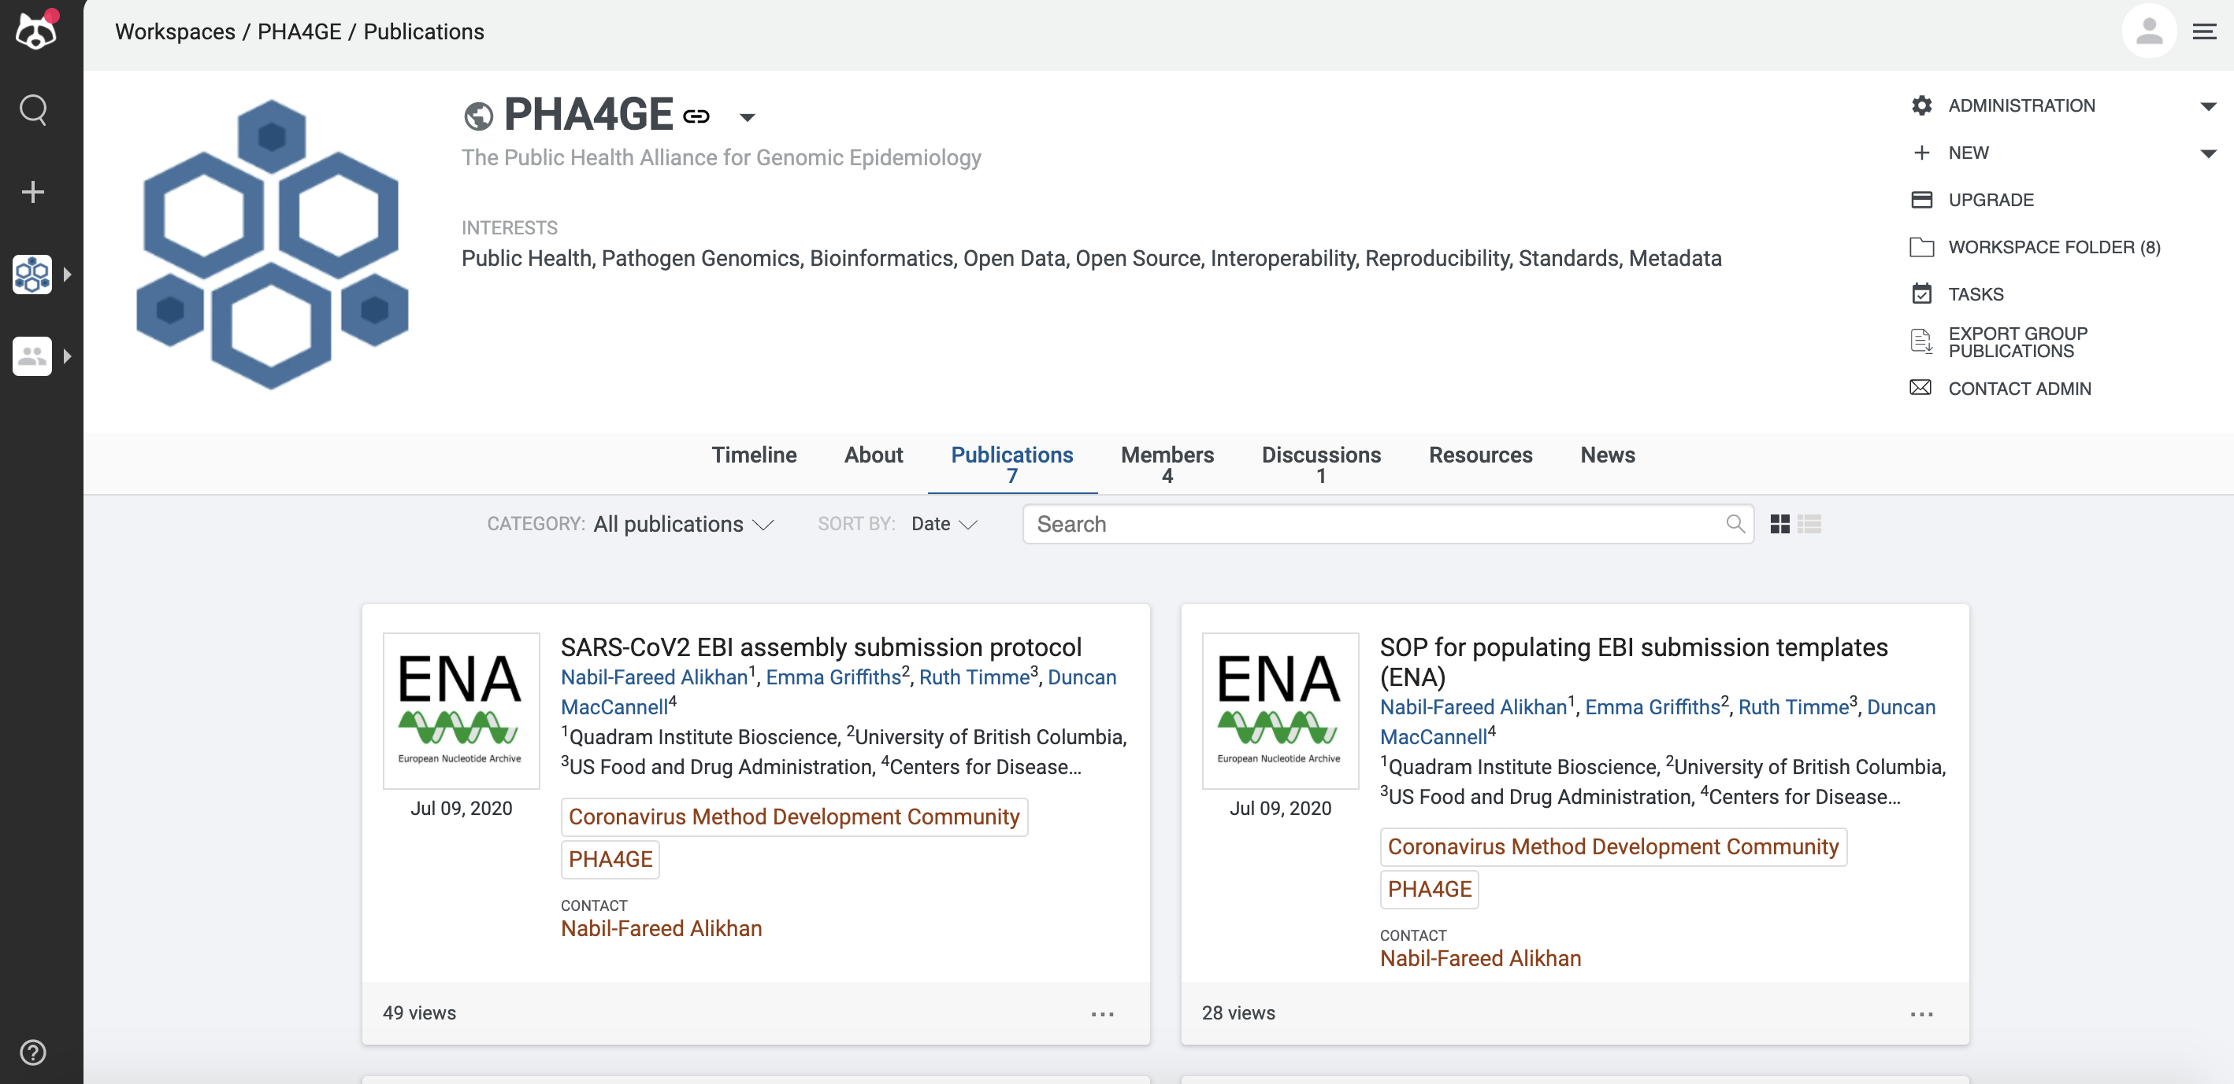
Protocols to mobilize harmonized data
7 public repository submission protocols (GISAID, NCBI, EMBL-EBI) on Protocols.io
PHA4GE-adapted submission forms
instructional videos
Different repositories have different fields, but PHA4GE helps standardize what goes into those fields.
https://www.protocols.io/workspaces/pha4ge

Slide 18

Data transformation tools: The DataHarmonizer
Tool for data entry and validation
Spreadsheet-style text editor application (PHA4GE template)
Picklists, data structure, validation, export
Guidance (reference guide), SOP
View all fields
View required fields
Move to desired field
Automate column fill
Validate
(check for errors or missing info)
Learn your way around the system
Double click on field labels for guidance on how to fill them
Save
Open existing file
Export to chosen format
https://github.com/Public-Health-Bioinformatics/DataHarmonizer/wiki/PHA4GE-SARS-CoV-2-Template

Slide 19
Data transformation tools: The DataHarmonizer
Enter data once, export in different submission formats i.e. GISAID and NCBI (BioSample, SRA, GenBank)
Complementary to multiSub (interchange between submission formats)
https://github.com/maximilianh/multiSub
https://github.com/Public-Health-Bioinformatics/DataHarmonizer/wiki/PHA4GE-SARS-CoV-2-Template

Slide 20
Data stewardship: oversight and practices to ensure data is accessible, usable, safe, trusted.
Privacy protection (sharing):
Public trust essential, loss of trust has consequences (protection, transparency)
De-identified data (no names/addresses)
Be careful of 1) geographical granularity, 2) small case numbers in defined geo_loc/time, 3) combinations of fields
Age/gender often shareable, sharing of clinical/epi information may be restricted at individual level (e.g. hospitalization, exposures)
Track identifiers (chain of custody), but personal health IDs may be considered PHII
Consult privacy officer (jurisdictional policies)
See curation SOP for details…
Contextual data can provide critical information in investigations of life or death situations.
Please consider when evaluating privacy concerns (see GA4GH’s Human rights argument for prioritizing sharing).
https://www.ga4gh.org/genomic-data-toolkit/regulatory-ethics-toolkit/framework-for-responsible-sharing-of-genomic-and-health-related-data/

Slide 21
Data stewardship: oversight and practices to ensure data is accessible, usable, safe, trusted
FAIR stewardship best practices (Wilkinson et al (2016), Nature):
Findable, Accessible, Interoperable, Reusable
Standards help preserve integrity and meaning of data (now and in future) for YOU and others
Machine-actionable → indexed, searchable
Formal, broadly applicable language (data standards)
Security & Quality:
Provenance, methods (rich details) → attribution, auditability, reproducibility (track methods), accountability
Contextual data may require storage with higher security than seq data
Errors corrected, update as required

Slide 22

Summary: What can the PHA4GE spec do for you?
Data is more interpretable by humans and computers
Future-proof contextual data
Harmonize and integrate data across labs/databases (interoperability)
Tools

Slide 23
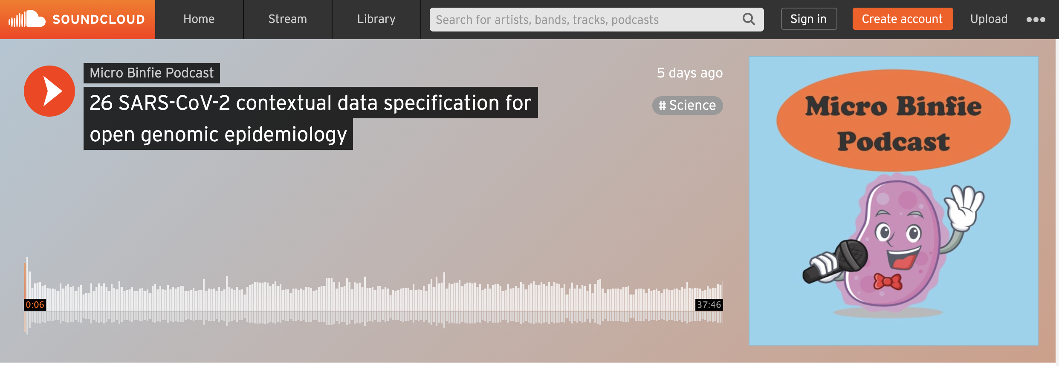
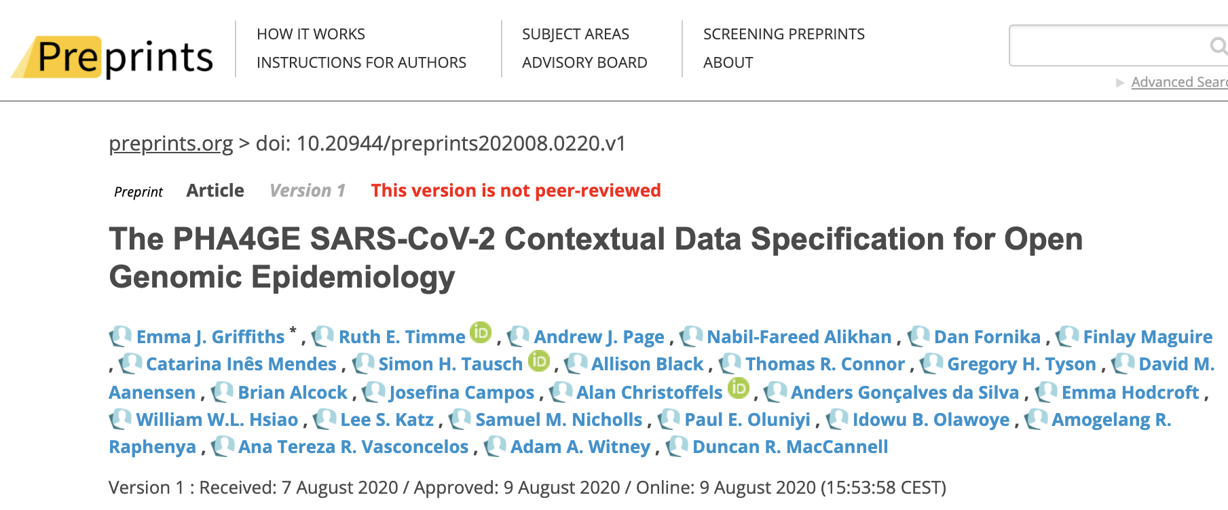
Learn more…
Listen to episode 26 Micro Binfie podcast
https://soundcloud.com/microbinfie/26-sars-cov-2-metadata#t=0:00
Read our preprint
Update coming out soon!
https://www.preprints.org/manuscript/202008.0220/v1

Slide 24
Special thanks to…
Data Structures Team
Ana Ribeiro de Vasconcelos
Josefina Campos
Idowu Olawoye
Paul Oluniyi
Adam Witney
Andrew Page
David Aanensen
Ines Mendes
Emma Hodcroft
Simon Tausch
Allison Black
Ruth Timme
Greg Tyson
Mike Feldgarden
Lee Katz
Brian Alcock
Amos Raphenya
Finlay Maguire
Dan Fornika
Duncan MacCannell
Specification Contributors
& Partners
Nabil-Fareed Alikhan
Alan Christoffels
Will Hsiao
Sam Nicholls
Tom Connor
Anders Gonçalves da Silva
Dominique Anderson
Danny Park
CDC TOAST Team
Steering Committee &
Secretariat
Jamie Southgate
Alecia Naidu
Rangarirai Matima
Nawaal Nacerodien
Peter van Heusden
Kevin Libuit
Nicola Mulder
Nicki Tiffin
Find the spec package:
https://github.com/pha4ge/SARS-CoV-2-Contextual-Data-Specification
Find us:
https://www.pha4ge.org
@pha4ge
datastructures@pha4ge.org

